Slide 1
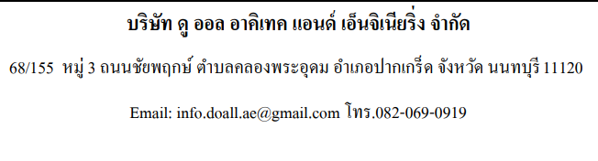
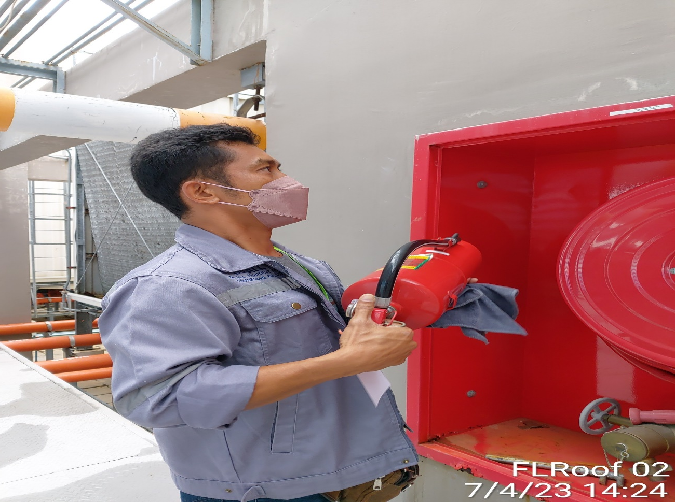
Performance Test of Fire Extinguisher
Project Location
: Holiday Inn Pattaya (Bay Tower)
: 463/68,463/99 Pattaya Sai 1 Road, Nongprue Banglamung, Chonburi, Pattaya, 20150
Inspection date : 7 April 2023
Inspector : By Do All Architect And Engineering Ltd.
Inspection (Year 2023)
Page 1 of 10

Slide 2

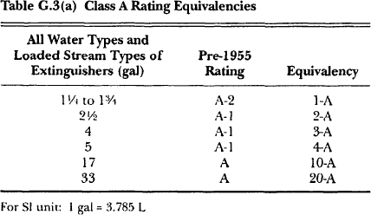
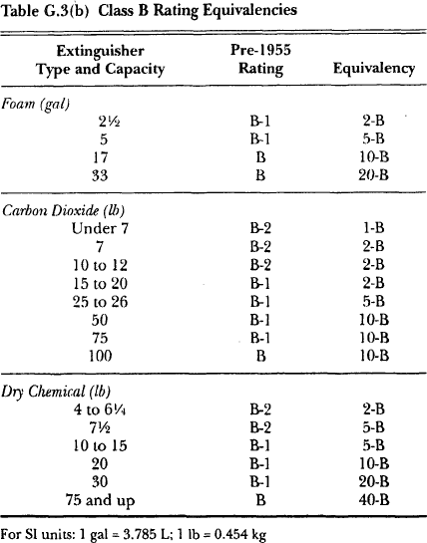
P. S GRAND GROUP LTD., PART.
2/85 Soi Banhkhuntien 16, Samaedum, Bangkhuntien, Bangkok
Tel. 02-451-0921, 081-839-3461 Fax.02-451-0922
contact@psinspector.com
www.psinspector.com
Managing Director:
Montre Sawangpanich
NFPA 10
Standard for Portable Fire Extinguishers
Executive Director:
Piya Sawangpanich
Chapter I Administration
Classification, Ratings, and Performance of Fire Extinguishers. (See Annex G.)
* The identification of the listing and labeling organization, the fire test, and the performance standard that the fire extinguisher meets or exceeds shall be clearly marked on each fire extinguisher.
* An organization listing tire extinguishers used to comply with the requirements of this standard shall utilize a third party certification program for portable fire extinguishers that meets or exceeds ANSI/UL 1803, Standard for Factory Follow-up on Third Party Certified Portable Fire Extinguishers.
Annex G Extinguisher Classification
Inspection (Year 2023)
Page 2 of 10

Slide 3
P. S GRAND GROUP LTD., PART.
2/85 Soi Banhkhuntien 16, Samaedum, Bangkhuntien, Bangkok
Tel. 02-451-0921, 081-839-3461 Fax.02-451-0922
contact@psinspector.com
www.psinspector.com
Managing Director:
Montre Sawangpanich
Executive Director:
Piya Sawangpanich
Chapter 3 Definitions
3.2 NFPA Official Definitions.
Classifications for Fires.
Class A Fires. Fires in ordinal)l combustible materials, such as wood, cloth, paper, rubber, and many plastics.
Class B Fires. Fires in flammable liquids, combustible liquids, petroleum greases, tars, oils, oil-based paints, solvents, lacquers, alcohols, and flammable gases.
Class C Fires. Fires that involve energized electrical equipment.
Class D Fires. Fires in combustible metals. such as magnesium, titanium, zirconium, sodium, lithium, and potassium.
Class KFrres. Fires in cooking appliances that involve combustible cooking media (vegetable or animal oils and fats).
3.3.7* Dry Chemical. A mixture of finely divided solid particles, usually sodium bicarbonate-, potassium bicarbonate-, or ammonium phosphate-based with added particulate material supplemented by special treatment to provide resistance to packing, and moisture absorption (caking), and to promote proper flow characteristics.
3.3.10 Extinguisher Inspection. A "quick check" that a fire extinguisher is available and is in operating condition. It is intended to give reasonable assurance that the fire extinguisher is fully charged. This is done by verifying that it is in its designated place, that it has not been actuated or tampered with, and that there is no obvious physical damage or condition to prevent its operation.
Inspection (Year 2023)
Page 3 of 10

Slide 4
P. S GRAND GROUP LTD., PART.
2/85 Soi Banhkhuntien 16, Samaedum, Bangkhuntien, Bangkok
Tel. 02-451-0921, 081-839-3461 Fax.02-451-0922
contact@psinspector.com
www.psinspector.com
Managing Director:
Montre Sawangpanich
Executive Director:
Piya Sawangpanich
D.4 Fire Extinguisher Characteristics.
D.4.3 Carbon Dioxide Type. This type of fire extinguisher is primarily intended for use on Class B and Class C fires. Carbon dioxide fire extinguishers have a limited range and are affected by draft and wind; thus, initial applicat.ion needs to start reasonably close to the fire. On all fires, the discharge should be directed at the base of the flames. The discharge should be applied 1.0 the burning surface even after the flames are extinguished to allow added time for cooling and to prevent possible reflash. The most commonly used method of agent application on contained flammable liquid fires is to start at the
near edge and direct the discharge in a slow. side-to-side sweeping motion, gradually progressing toward the back of
the fire. The other method is caIled overhead application. The discharge horn is directed in a dagger or downward position (at an angle of about 45 degrees) toward the center of the burning area. Generally, the horn is not moved, as in the other method, because the discharge stream enters the tire from above and spreads out in all directions over the burning surface. For spill tires, the side-to-side sweeping motion could give better results.
On fires involving electrical equipment, discharge should be directed at the source of the flames. It is important to de-energize the equipment as soon as possible to eliminate the potential of reignition. These agents are not suitable for use on pressurized fuel fires or cooking-grease fires.
The carbon dioxide agent extinguishes by diluting the surrounding atmosphere with an inert gas so that oxygen levels are kept below the percentage required for combustion. When this type of fire extinguisher is used in an unventilated
space, such as a small room, closet, or other eon tilled area, prolonged occupancy of that space can result in the loss of consciousness due to oxygen deficiency.
Hand fire extinguishers of this type are usually available at capacities from 2Y2 lb to 20 lb (1.] kg to 9.1 kg). having fire extinguishment ratings from l-B:C to 10-B:C. Carbon dioxide fire extinguishers might have a limited effect on deep-seated
fires in electrical enclosures. Wheeled carbon dioxide tire extinguishers are usually available in capacities from 50 Ib to 100 lb (23 kg to 45 kg), having fire extinguishment ratings from 10-B:C to 20-B:C. The carbon dioxide is retained under
its own pressure in a fluid condition at room temperature. The agent is self-expelling and is discharged by operation of a valve
that causes the carbon dioxide to be expelled through a horn in its vapor and solid phase. To be operated, the fire extinguisher is held in an upright position. the locking ring pin is pulled, and the operating lever is squeezed. On the smaller 2 lb to 5 lb (0.9] kg to 2.3 kg) models. the discharge horn is attached to the valve assembly hy a metal tube/swing joint connector. The smaller models are designed to be operated with one hand. On the larger hand portables. the discharge hom is attached to several feet of flexible hose. These fire extinguishers require a "two-hand" operation. The minimum discharge time for hand portables varies from 8 seconds to 30 seconds, depending upon size. The maximum range of the discharge su"eam is from 3 ft to 8 ft (l m to 2.4 m). [See Figure D.4.3(a) and Figure D.4.3(b).J
Inspection (Year 2023)
Page 4 of 10

Slide 5
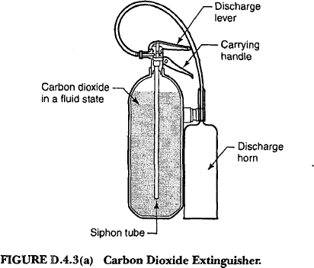
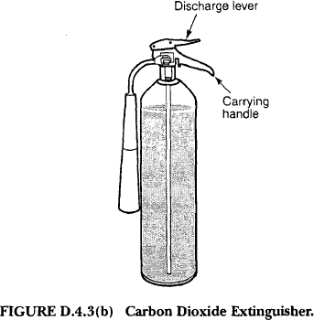
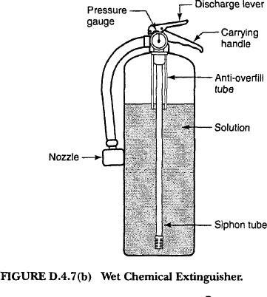
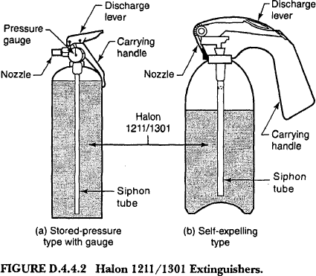
P. S GRAND GROUP LTD., PART.
2/85 Soi Banhkhuntien 16, Samaedum, Bangkhuntien, Bangkok
Tel. 02-451-0921, 081-839-3461 Fax.02-451-0922
contact@psinspector.com
www.psinspector.com
Managing Director:
Montre Sawangpanich
Executive Director:
Piya Sawangpanich
D .4.4.2 Bromochlorodifluoromethane / Bromotrifluoromethane Mixtures - Halon 1211 and Halon 1301. Fire extinguishers of this type are available in capacities from l.0 Ib to 20 lb (0.45 kg to 9 kg), having fire extinguishment ratings from l-B:C to
4-A:80-B:C. The halogenated agent mixture is retained under pressure in a liquid state and is self-expelling. Some of these fire extinguishers are superpressurized with nitrogen. Upon actuation, the vapor pressure causes the agent to expand so that the discharge stream is in the form of a gas/mist. These extinguishers have a horizontal stream range of 3 ft to 18 ft
(0.9 m [05.5 m) that is not affected by wind as much as carbon dioxide or Halon 1301. Deep-seated Class A fires could need to be broken apart to effect complete extinguishment. On Class B fires. the discharge is applied in a side-to-side motion. progressing toward the back of the fire. (See Figure D.4.4.2.)
Inspection (Year 2023)
Page 5 of 10

Slide 6
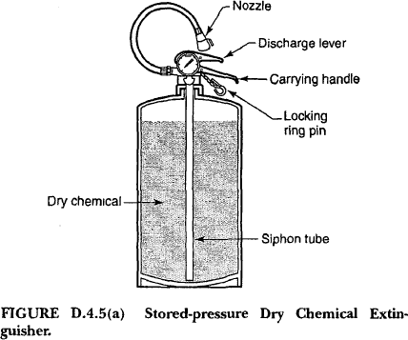
P. S GRAND GROUP LTD., PART.
2/85 Soi Banhkhuntien 16, Samaedum, Bangkhuntien, Bangkok
Tel. 02-451-0921, 081-839-3461 Fax.02-451-0922
contact@psinspector.com
www.psinspector.com
Managing Director:
Montre Sawangpanich
Executive Director:
Piya Sawangpanich
D.4.5 Dry Chemical Types. Dry chemical fire extinguishers (sodium bicarbonate, potassium bicarbonate, potassium bicarbonate urea base, bicarbonate urea base, or potassium chloride base) are intended primarily for use on Class Band Class C fires. Dry chemical fire extinguishers (multipurpose ammonium phosphate base) are intended for use on Class A, Class B, and Class C fires. There are two methods whereby a dry chemical agent can be discharged from a fire extinguisher shell, depending on the basic design of the fire extinguisher. They are the cartridge/ cylinder-operated method and the stored-pressure method. Regardless of tire extinguisher design, the method of agent application is basically the same. Stored-pressure fire extinguishers are available in capacities from 1 Ib t0 30 Ib (0.5 kg to 14 kg) for hand fire extinguishers and 125 kg to 250 lb (57 kg to 113.5 kg) for wheeled fire extinguishers. Cartridge/ cylinder-operated fire extinguishers are available in capacities from 4 Ib to 30 Ib (1.8 kg to 14 kg) for hand fire extinguishers and 45 Ib to 350 Ib (20 kg to 159 kg) for wheeled fire extinguishers.
Dry chemical fire extinguishers are also available in nonrechargeable, nonrefillable types that contain the agent and expellant gas in a single, nonreusable, factory-tilled container. ft.1ost dry chemical fire extinguishers having ratings of 20-B and less will discharge their contents in 8 seconds to 20 seconds. Fire extinguishers with higher ratings could take as long as 30 seconds. Therefore, since there is little time for experimentation, it is important that the operator be prepared to
apply the agent correctly at the outset. AU dry chemical fire extinguishers can be carried and operated simultaneously and can be discharged intermittently. The discharge stream has a horizontal range of5 ft to 30 ft (1.5 m to 9.2 m), depending on tire extinguisher size. When used on outdoor tires, maximum effectiveness can be achieved when the direction of the wind is on the back of the operator. [See Figure D. 4.5( a) and Figure D.4.5(b).J
Inspection (Year 2023)
Page 6 of 10

Slide 7
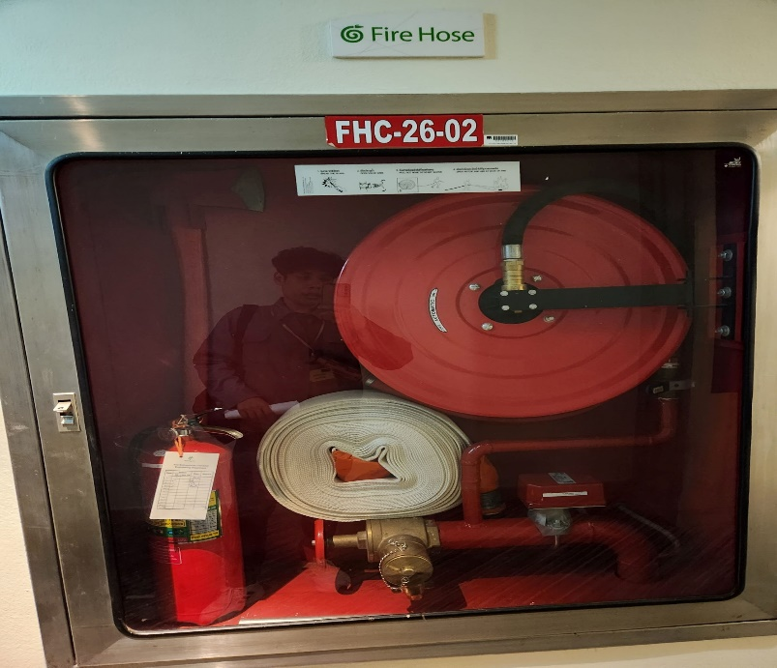
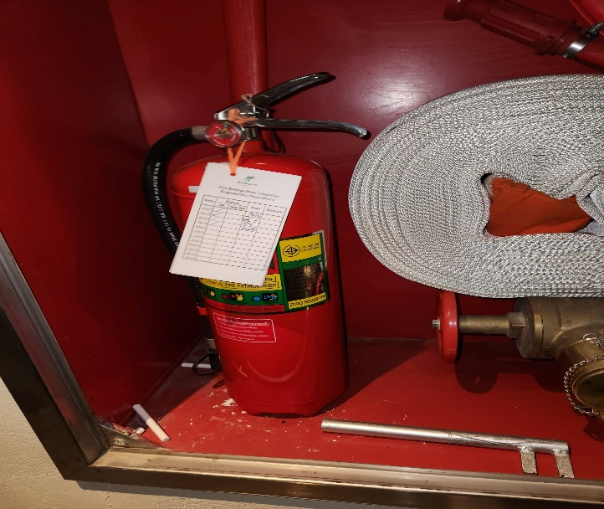
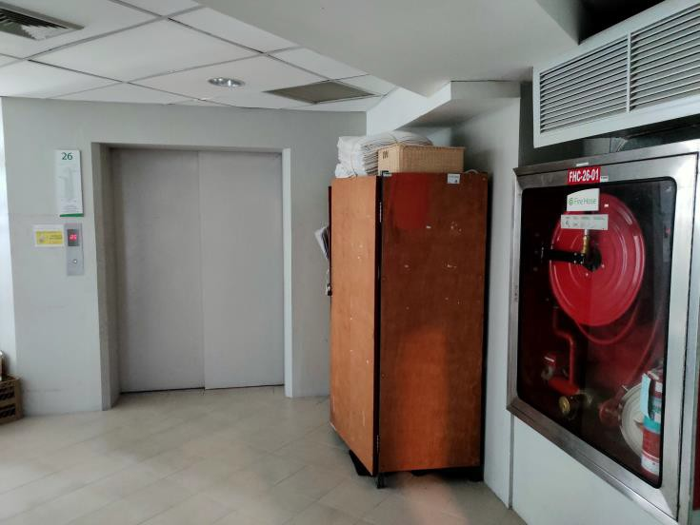
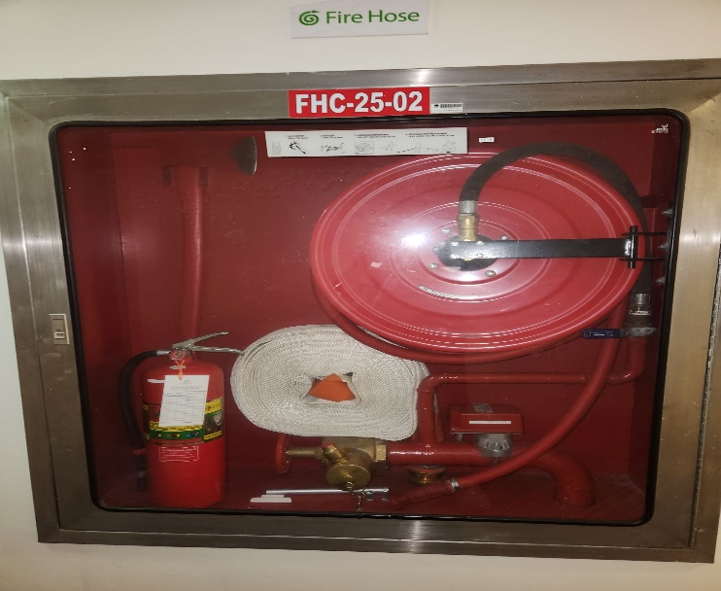
P. S GRAND GROUP LTD., PART.
2/85 Soi Banhkhuntien 16, Samaedum, Bangkhuntien, Bangkok
Tel. 02-451-0921, 081-839-3461 Fax.02-451-0922
contact@psinspector.com
www.psinspector.com
Managing Director:
Montre Sawangpanich
Executive Director:
Piya Sawangpanich
Chapter 6 Inspection, Maintenance, and Recharging
Inspection.
* Frequency. Fire extinguishers shall be inspected when initially placed in service and thereafter at approximately 30-
day intervals. Fire extinguishers shall be inspected. Manually or by electronic monitoring. at more frequent intervals when circumstances require.
* Procedures. Periodic inspection of tire extinguishers shall include a check of at least the following items:
(1) Location in designated place
(2) No obstruction to access or visibility
Inspection (Year 2023)
Page 7 of 10

Slide 8
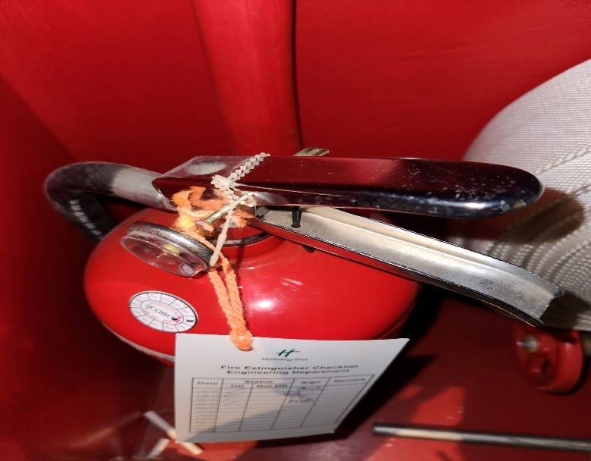
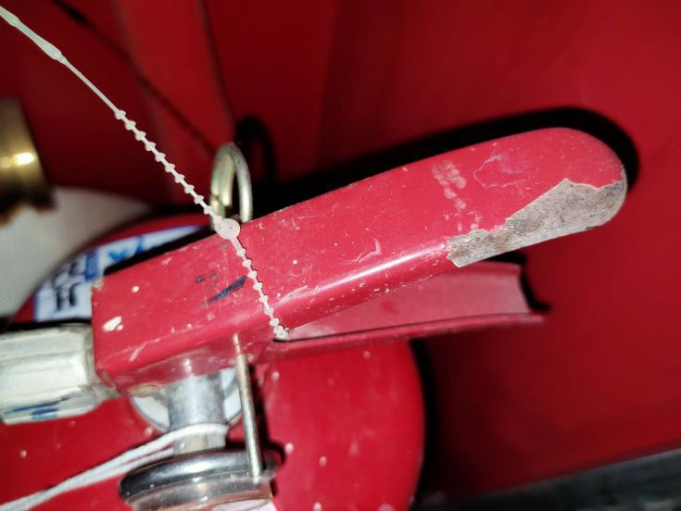
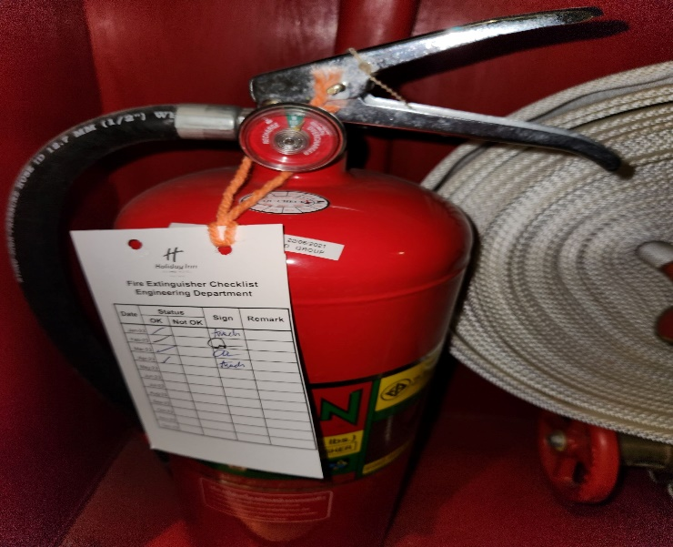
P. S GRAND GROUP LTD., PART.
2/85 Soi Banhkhuntien 16, Samaedum, Bangkhuntien, Bangkok
Tel. 02-451-0921, 081-839-3461 Fax.02-451-0922
contact@psinspector.com
www.psinspector.com
Managing Director:
Montre Sawangpanich
Executive Director:
Piya Sawangpanich
(3) Operating instructions on nameplate legible and facing outward
(4)*Safety seals and tamper indicators not broken or missing
Inspection (Year 2023)
Page 8 of 10

Slide 9
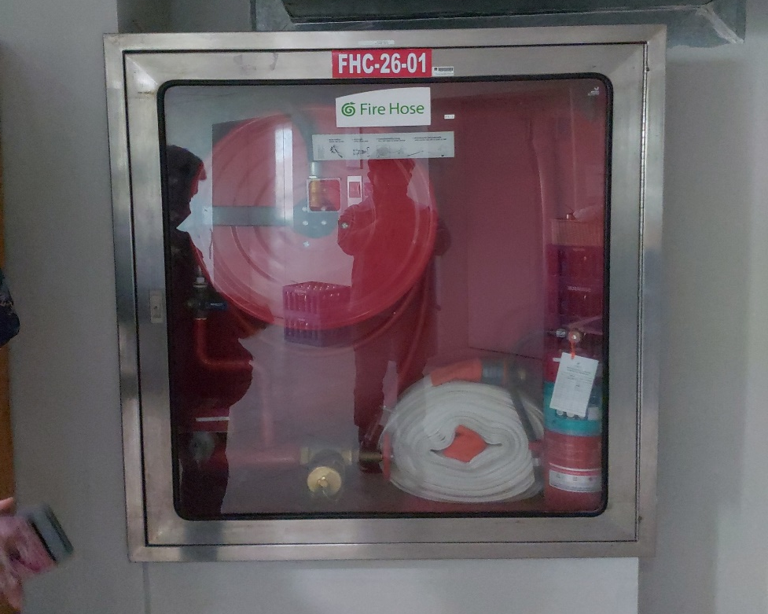
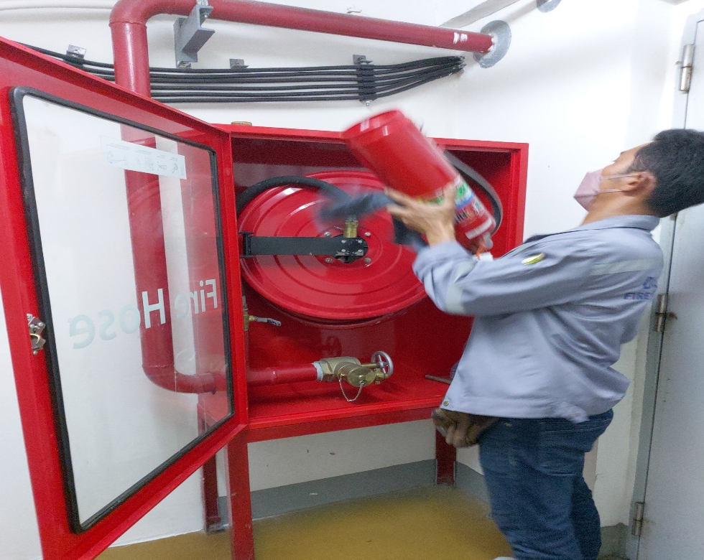
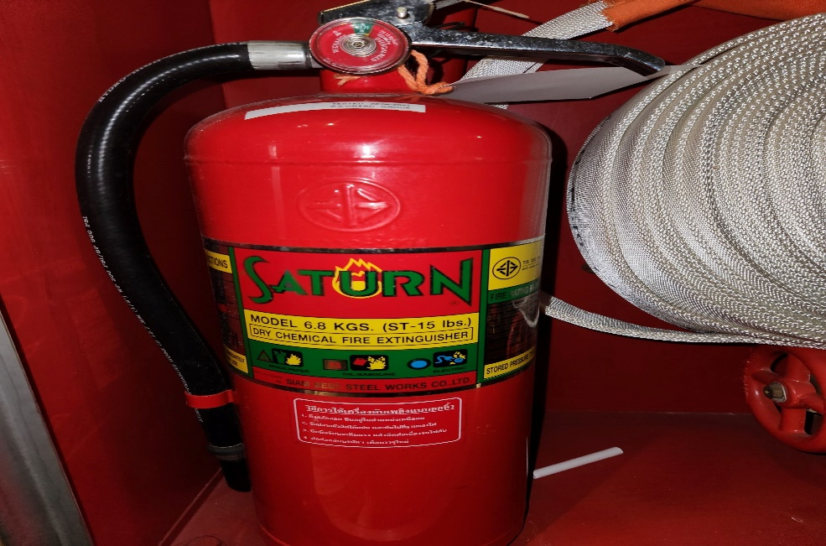
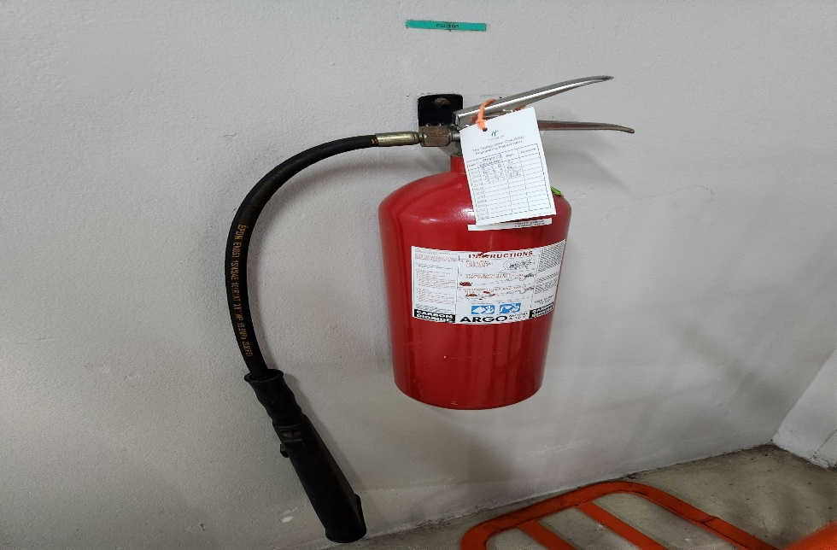
P. S GRAND GROUP LTD., PART.
2/85 Soi Banhkhuntien 16, Samaedum, Bangkhuntien, Bangkok
Tel. 02-451-0921, 081-839-3461 Fax.02-451-0922
contact@psinspector.com
www.psinspector.com
Managing Director:
Montre Sawangpanich
Executive Director:
Piya Sawangpanich
Fullness determined by weighing or "hefting"
Examination for obvious physical damage, corrosion, leakage, or clogged nozzle
Pressure gauge reading or indicator in the operable range or position
(8) Condition of tires, wheels, carriage, hose. and nozzle checked (for wheeled units)
Inspection (Year 2023)
Page 9 of 10

Slide 10
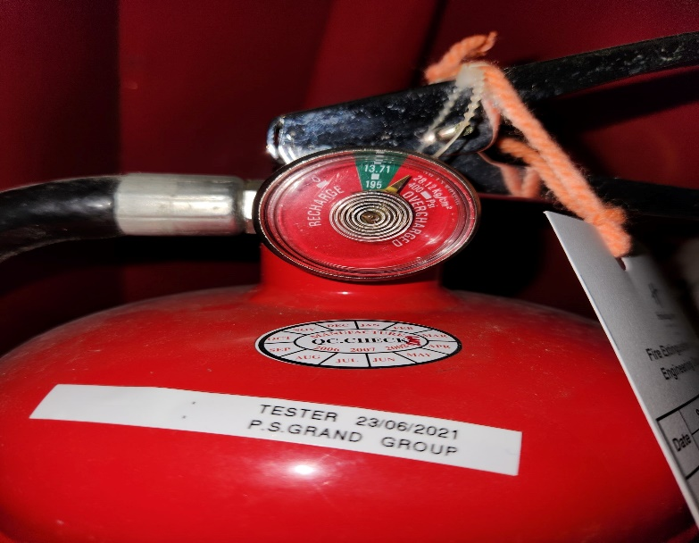

P. S GRAND GROUP LTD., PART.
2/85 Soi Banhkhuntien 16, Samaedum, Bangkhuntien, Bangkok
Tel. 02-451-0921, 081-839-3461 Fax.02-451-0922
contact@psinspector.com
www.psinspector.com
Managing Director:
Montre Sawangpanich
Executive Director:
Piya Sawangpanich
(9) HMIS label in place
Corrective Action. When an inspection or any fire extinguisher
reveals a deficiency in any of the conditions listed in 6.2.2, immediate corrective action shall be taken.
Rechargeable Fire Extinguishers. When an inspection of any rechargeable fire extinguisher reveals a deficiency
in any of the conditions listed in 6.2.2(3), (4), (5),(6), (7), and (8), it shall be subjected to applicable maintenance procedures.
6.2.4 Inspection Recordkeeping.
* Fire Extinguisher cleaning and paste sticker
6.4 Recharging.
* V\'hen performing the recharging, the recommendations of me manufacturer shall be followed. (For recharge chemicals, see 6.4.3. J.)
* The amount of recharge agent shall be verified by weighing. The recharged gross weight shall be the same as the
gross weight that is marked on me label. For those fire extinguishers that do not have the gross weight marked on the label. a permanent label that indicates the gross weight shall be affixed to the cylinder. The label containing the gross weight shall be a durable material of a pressure-sensitive. Self-destruct type.
Conversion of Fire .Extinguisher Types. No fire. extinguisher shall be converted from one type LO another, nor shall any fire extinguisher be converted to use a different type of extinguishing agent. Fire extinguishers shall not be used for any other purpose man that of a fire extinguisher.
* Leak Test. After recharging, a leak test shall be performed on stored-pressure and self-expelling types of fire
extinguishers.
Inspection (Year 2023)
Page 10 of 10

Slide 11
HOTEL : Holiday Inn Pattaya
PORTABLE FIRE EXTINGUISHER / HOSE REAL CHECK RECORD SHEET ( MONTHLY)
Total Fire Extinguisher | 64 | 64 | Units
Useable | 49 | 49 | Units
Anusable | 3 | 3 | Units
No have Fire Extinguisher | 0 | 0 | Units
หลักเกณฑ์การให้ NO
-พบปัญหาสนิมตั้งแต่ 2 จุดขึ้นไปหรือสนิมรอบถัง
-อุปกรณ์ไม่ครบ
- ไม่มี มอก. หรือ UL
- แรงดันน้ำหนักตกหรือเกิน
-น้ำหนักน้อยกว่าผู้ผลิตกำหนด
รายการอื่นๆจะให้ลูกค้าพิจารณาครับ
- Fire Rating
- สงิ่ กีดขวาง

Slide 12
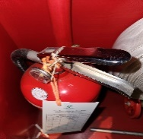
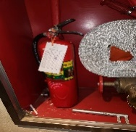
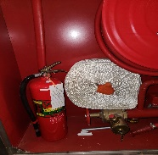
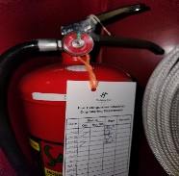
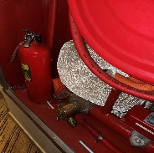
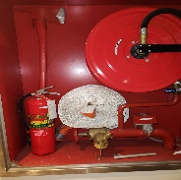
No. | Floor No. | Location | ป้ายสัญญาลักษณ์ | พื้นที่โด ย ร อ บไม่มี | สภาพถัง | คันบีบ, | สายฉีด | น้ำยา | แรงดัน | น้าหนัก | น้ำหนัก | Test Results |  | หมายเหตุ
 |  |  | มีชี้บ่ง ชัด เจน | สิ่งกีดขวาง |  | สลักกันนิรภัย, |  |  |  | (CO₂) kg. | (CO₂) kg. | yes | No
 |  |  | Sign | General Area |  | ซีลล็อค |  |  |  | ผุ้ผลิต | ที่วัดได้
1 | 26 | Service Lift | ✓ | ✓ | ✓ | ✓ | ✓ | ✓ | ✓ |  |  | ✓
2 | 26 | Customer Lift | ✓ | ✓ | ✓ | ✓ | ✓ | ✓ | ✓ |  |  | ✓
3 | 25 | Customer Lift | ✓ | ✓ | ✓ | ✓ | ✓ | ✓ | ✓ |  |  | ✓
4 | 25 | Service Lift | ✓ | ✓ | ✓ | ✓ | ✓ | ✓ | ✓ |  |  | ✓
5 | 24 | Service Lift | ✓ | ✓ | ✓ | ✓ | ✓ | ✓ | ✓ |  |  | ✓
6 | 24 | Customer Lift | ✓ | ✓ | ✓ | ✓ | ✓ | ✓ | ✓ |  |  | ✓

Slide 13
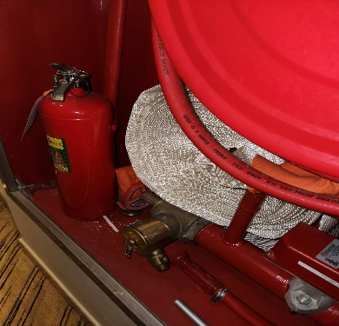
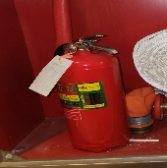
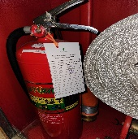
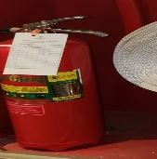
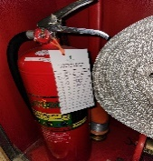
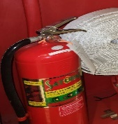
No. | Floor No. | Location | ป้ายสัญญาลักษณ์ | พื้นที่โด ย ร อ บไม่มี | สภาพถัง | คันบีบ, | สายฉีด | น้ำยา | แรงดัน | น้าหนัก | น้ำหนัก | Test Results |  | หมายเหตุ
 |  |  | มีชี้บ่ง ชัด เจน | สิ่งกีดขวาง |  | สลักกันนิรภัย, |  |  |  | (CO₂) kg. | (CO₂) kg. | yes | No
 |  |  | Sign | General Area |  | ซีลล็อค |  |  |  | ผุ้ผลิต | ที่วัดได้
7 | 23 | Customer Lift | ✓ | ✓ | ✓ | ✓ | ✓ | ✓ | ✓ |  |  | ✓
8 | 23 | Service Lift | ✓ | ✓ | ✓ | ✓ | ✓ | ✓ | ✓ |  |  | ✓
9 | 22 | Customer Lift | ✓ | ✓ | ✓ | ✓ | ✓ | ✓ | ✓ |  |  | ✓
10 | 22 | หน้าห้อง บรรไดหนีไฟ ST-22 | ✓ | ✓ | ✓ | ✓ | ✓ | ✓ | ✓ |  |  | ✓
11 | 21 | Customer Lift | ✓ | ✓ | ✓ | ✓ | ✓ | ✓ | ✓ |  |  | ✓
12 | 21 | Service Lift | ✓ | ✓ | ✓ | ✓ | ✓ | ✓ | ✓ |  |  | ✓

Slide 14
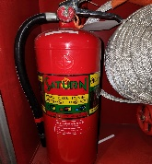
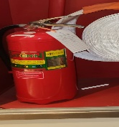
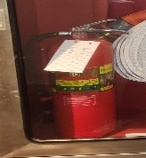
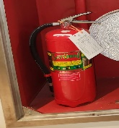
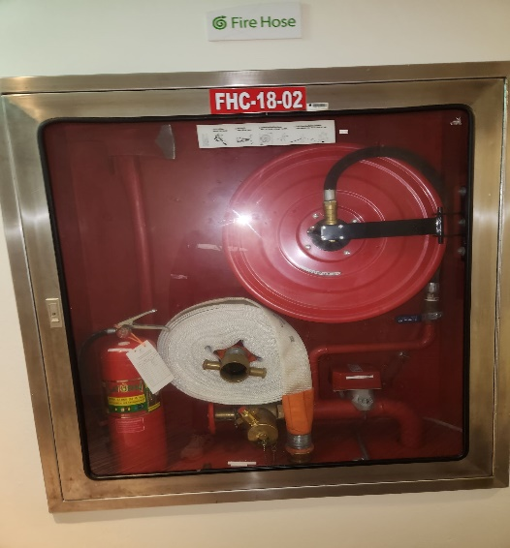

No. | Floor No. | Location | ป้ายสัญญาลักษณ์ | พื้นที่โด ย ร อ บไม่มี | สภาพถัง | คันบีบ, | สายฉีด | น้ำยา | แรงดัน | น้าหนัก | น้ำหนัก | Test Results |  | หมายเหตุ
 |  |  | มีชี้บ่ง ชัด เจน | สิ่งกีดขวาง |  | สลักกันนิรภัย, |  |  |  | (CO₂) kg. | (CO₂) kg. | yes | No
 |  |  | Sign | General Area |  | ซีลล็อค |  |  |  | ผุ้ผลิต | ที่วัดได้
13 | 20 | Service Lift | ✓ | ✓ | ✓ | ✓ | ✓ | ✓ | ✓ |  |  | ✓
14 | 20 | Customer Lift | ✓ | ✓ | ✓ | ✓ | ✓ | ✓ | ✓ |  |  | ✓
15 | 19 | Service Lift | ✓ | ✓ | ✓ | ✓ | ✓ | ✓ | ✓ |  |  | ✓
16 | 19 | Customer Lift | ✓ | ✓ | ✓ | ✓ | ✓ | ✓ | ✓ |  |  | ✓
17 | 18 | Customer Lift | ✓ | ✓ | ✓ | ✓ | ✓ | ✓ | ✓ |  |  | ✓
18 | 17 | Customer Lift | ✓ | ✓ | ✓ | ✓ | ✓ | ✓ | ✓ |  |  | ✓

Slide 15
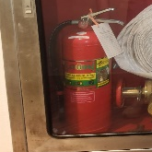
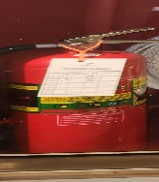
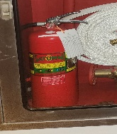
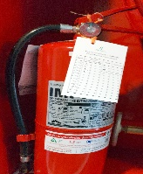
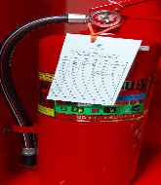
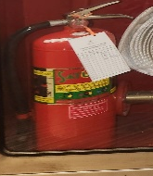
No. | Floor No. | Location | ป้ายสัญญาลักษณ์ | พื้นที่โด ย ร อ บไม่มี | สภาพถัง | คันบีบ, | สายฉีด | น้ำยา | แรงดัน | น้าหนัก | น้ำหนัก | Test Results |  | หมายเหตุ
 |  |  | มีชี้บ่ง ชัด เจน | สิ่งกีดขวาง |  | สลักกันนิรภัย, |  |  |  | (CO₂) kg. | (CO₂) kg. | yes | No
 |  |  | Sign | General Area |  | ซีลล็อค |  |  |  | ผุ้ผลิต | ที่วัดได้
19 | 17 | Service Lift | ✓ | ✓ | ✓ | ✓ | ✓ | ✓ | ✓ |  |  | ✓
20 | 16 | Service Lift | ✓ | ✓ | ✓ | ✓ | ✓ | ✓ | ✓ |  |  | ✓
21 | 16 | Customer Lift | ✓ | ✓ | ✓ | ✓ | ✓ | ✓ | ✓ |  |  | ✓
22 | 15 | Customer Lift | ✓ | ✓ | ✓ | ✓ | ✓ | ✓ | ✓ |  |  | ✓
23 | 15 | Service Lift | ✓ | ✓ | ✓ | ✓ | ✓ | ✓ | ✓ |  |  | ✓
24 | 14 | Service Lift | ✓ | ✓ | ✓ | ✓ | ✓ | ✓ | ✓ |  |  | ✓

Slide 16
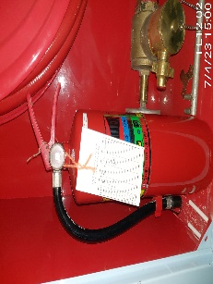
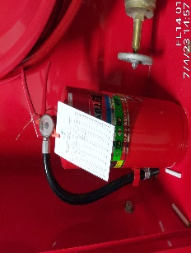

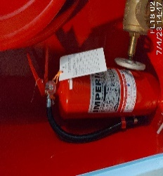
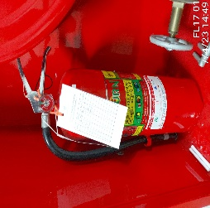
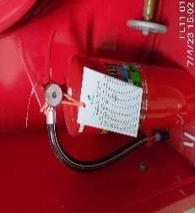
No. | Floor No. | Location | ป้ายสัญญาลักษณ์ | พื้นที่โด ย ร อ บไม่มี | สภาพถัง | คันบีบ, | สายฉีด | น้ำยา | แรงดัน | น้าหนัก | น้ำหนัก | Test Results |  | หมายเหตุ
 |  |  | มีชี้บ่ง ชัด เจน | สิ่งกีดขวาง |  | สลักกันนิรภัย, |  |  |  | (CO₂) kg. | (CO₂) kg. | yes | No
 |  |  | Sign | General Area |  | ซีลล็อค |  |  |  | ผุ้ผลิต | ที่วัดได้
25 | 14 | Customer Lift | ✓ | ✓ | ✓ | ✓ | ✓ | ✓ | ✓ |  |  | ✓
26 | 14 | Customer Lift | ✓ | ✓ | ✓ | ✓ | ✓ | ✓ | ✓ |  |  | ✓
27 | 14 | หน้าห้องบรรไดหนีไฟ ST-14 | ✓ | ✓ | ✓ | ✓ | ✓ | ✓ | ✓ |  |  | ✓
28 | 12 | หน้าห้อง บรรไดหนีไฟ ST-12 | ✓ | ✓ | ✓ | ✓ | ✓ | ✓ | ✓ |  |  | ✓
29 | 12 | Customer Lift | ✓ | ✓ | ✓ | ✓ | ✓ | ✓ | ✓ |  |  | ✓
30 | 11 | Service Lift | ✓ | ✓ | ✓ | ✓ | ✓ | ✓ | ✓ |  |  | ✓

Slide 17
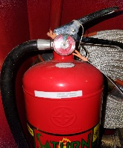





No. | Floor No. | Location | ป้ายสัญญาลักษณ์ | พื้นที่โด ย ร อ บไม่มี | สภาพถัง | คันบีบ, | สายฉีด | น้ำยา | แรงดัน | น้าหนัก | น้ำหนัก | Test Results |  | หมายเหตุ
 |  |  | มีชี้บ่ง ชัด เจน | สิ่งกีดขวาง |  | สลักกันนิรภัย, |  |  |  | (CO₂) kg. | (CO₂) kg. | yes | No
 |  |  | Sign | General Area |  | ซีลล็อค |  |  |  | ผุ้ผลิต | ที่วัดได้
31 | 11 | Service Lift | ✓ | ✓ | ✓ | ✓ | ✓ | ✓ | ✓ |  |  | ✓
32 | 11 | Customer Lift | ✓ | ✓ | ✓ | ✓ | ✓ | ✓ | ✓ |  |  | ✓
33 | 10 | หนา้ หอ้ ง บรรไดหนีไฟ ST-10 | ✓ | ✓ | ✓ | ✓ | ✓ | ✓ | ✓ |  |  | ✓
34 | 10 | Customer Lift | ✓ | ✓ | ✓ | ✓ | ✓ | ✓ | ✓ |  |  | ✓
35 | 10 | Service Lift | ✓ | ✓ | ✓ | ✓ | ✓ | ✓ | ✓ |  |  | ✓
36 | 9 | Service Lift | ✓ | ✓ | ✓ | ✓ | ✓ | ✓ | ✓ |  |  | ✓

Slide 18






No. | Floor No. | Location | ป้ายสัญญาลักษณ์ | พื้นที่โด ย ร อ บไม่มี | สภาพถัง | คันบีบ, | สายฉีด | น้ำยา | แรงดัน | น้าหนัก | น้ำหนัก | Test Results |  | หมายเหตุ
 |  |  | มีชี้บ่ง ชัด เจน | สิ่งกีดขวาง |  | สลักกันนิรภัย, |  |  |  | (CO₂) kg. | (CO₂) kg. | yes | No
 |  |  | Sign | General Area |  | ซีลล็อค |  |  |  | ผุ้ผลิต | ที่วัดได้
37 | 9 | Customer Lift | ✓ | ✓ | ✓ | ✓ | ✓ | ✓ | ✓ |  |  | ✓
38 | 9 | หน้าหอ้ ง บรรไดหนีไฟ ST-9 | ✓ | ✓ | ✓ | ✓ | ✓ | ✓ | ✓ |  |  | ✓
39 | 8 | Customer Lift | ✓ | ✓ | ✓ | ✓ | ✓ | ✓ | ✓ |  |  | ✓
40 | 8 | Service Lift | ✓ | ✓ | ✓ | ✓ | ✓ | ✓ | ✓ |  |  | ✓
41 | 7 | Service Lift | ✓ | ✓ | ✓ | ✓ | ✓ | ✓ | ✓ |  |  | ✓
42 | 7 | Customer Lift | ✓ | ✓ | ✓ | ✓ | ✓ | ✓ | ✓ |  |  | ✓

Slide 19






No. | Floor No. | Location | ป้ายสัญญาลักษณ์ | พื้นที่โด ย ร อ บไม่มี | สภาพถัง | คันบีบ, | สายฉีด | น้ำยา | แรงดัน | น้าหนัก | น้ำหนัก | Test Results |  | หมายเหตุ
 |  |  | มีชี้บ่ง ชัด เจน | สิ่งกีดขวาง |  | สลักกันนิรภัย, |  |  |  | (CO₂) kg. | (CO₂) kg. | yes | No
 |  |  | Sign | General Area |  | ซีลล็อค |  |  |  | ผุ้ผลิต | ที่วัดได้
43 | 7 | หนา้ หอ้ ง บรรไดหนีไฟ ST-7 | ✓ | ✓ | ✓ | ✓ | ✓ | ✓ | ✓ |  |  | ✓
44 | 5 | Service Lift | ✓ | ✓ | ✓ | ✓ | ✓ | ✓ | ✓ |  |  | ✓
45 | 5 | ทางออกสปา | ✓ | ✓ | ✓ | ✓ | ✓ | ✓ | ✓ |  |  | ✓
46 | 4 | Service Lift | ✓ | ✓ | ✓ | ✓ | ✓ | ✓ | ✓ |  |  | ✓
47 | 4 | Customer Lift | ✓ | ✓ | ✓ | ✓ | ✓ | ✓ | ✓ |  |  | ✓
48 | M | Service Lift | ✓ | ✓ | ✓ | ✓ | ✓ | ✓ | ✓ |  |  | ✓

Slide 20






No. | Floor No. | Location | ป้ายสัญญาลักษณ์ | พื้นที่โด ย ร อ บไม่มี | สภาพถัง | คันบีบ, | สายฉีด | น้ำยา | แรงดัน | น้าหนัก | น้ำหนัก | Test Results |  | หมายเหตุ
 |  |  | มีชี้บ่ง ชัด เจน | สิ่งกีดขวาง |  | สลักกันนิรภัย, |  |  |  | (CO₂) kg. | (CO₂) kg. | yes | No
 |  |  | Sign | General Area |  | ซีลล็อค |  |  |  | ผุ้ผลิต | ที่วัดได้
49 | M | Service Lift | ✓ | ✓ | ✓ | ✓ | ✓ | ✓ | ✓ |  |  | ✓
50 | M | ข้าห้องบรรได หนีไฟ FST-03-3M | ✓ | ✓ | ✓ | ✓ | ✓ | ✓ | ✓ |  |  | ✓
51 | M | ข้าห้องบรรได หนีไฟ FST-02-M | ✓ | ✓ | ✓ | ✓ | ✓ | ✓ | ✓ |  |  | ✓
52 | L | หน้าห้อง Server room | ✓ | ✓ | ✓ | ✓ | ✓ | ✓ | ✓ |  |  | ✓
53 | ST | car park | ✓ | ✓ | ✓ | ✓ | ✓ | ✓ | ✓ |  |  | ✓
54 | ST | car park | ✓ | ✓ | ✓ | ✓ | ✓ | ✓ | ✓ |  |  | ✓

Slide 21






No. | Floor No. | Location | ป้ายสัญญาลักษณ์ | พื้นที่โด ย ร อ บไม่มี | สภาพถัง | คันบีบ, | สายฉีด | น้ำยา | แรงดัน | น้าหนัก | น้ำหนัก | Test Results |  | หมายเหตุ
 |  |  | มีชี้บ่ง ชัด เจน | สิ่งกีดขวาง |  | สลักกันนิรภัย, |  |  |  | (CO₂) kg. | (CO₂) kg. | yes | No
 |  |  | Sign | General Area |  | ซีลล็อค |  |  |  | ผุ้ผลิต | ที่วัดได้
55 | ST | car park | ✓ | ✓ | ✓ | ✓ | ✓ | ✓ | ✓ |  |  | ✓
56 | ST | หน้า Havana | ✓ | ✓ | ✓ | ✓ | ✓ | ✓ | ✓ |  |  | ✓
57 | ST | หน้าHavana | ✓ | ✓ | ✓ | ✓ | ✓ | ✓ | ✓ |  |  | ✓
58 | ST | หน้าห้องขยะ | ✓ | ✓ | ✓ | ✓ | ✓ | ✓ | ✓ |  |  | ✓
59 | ST | หน้าห้องรับของ | ✓ | ✓ | ✓ | ✓ | ✓ | ✓ | ✓ |  |  | ✓
60 | B | หน้าห้อง MDB | ✓ | ✓ | ✓ | ✓ | ✓ | ✓ | ✓ |  |  | ✓

Slide 22




No. | Floor No. | Location | ป้ายสัญญาลักษณ์ | พื้นที่โด ย ร อ บไม่มี | สภาพถัง | คันบีบ, | สายฉีด | น้ำยา | แรงดัน | น้าหนัก | น้ำหนัก | Test Results |  | หมายเหตุ
 |  |  | มีชี้บ่ง ชัด เจน | สิ่งกีดขวาง |  | สลักกันนิรภัย, |  |  |  | (CO₂) kg. | (CO₂) kg. | yes | No
 |  |  | Sign | General Area |  | ซีลล็อค |  |  |  | ผุ้ผลิต | ที่วัดได้
61 | B | หน้าห้อง MDB | ✓ | ✓ | ✓ | ✓ | ✓ | ✓ | ✓ |  |  | ✓
62 | B | Work Shop | ✓ |  | ✓ | ✓ | ✓ | ✓ | ✓ |  |  | ✓
63 | B | Work Shop | ✓ | ✓ | ✓ |  | ✓ | ✓ | ✓ |  |  | ✓
64 | B | Work Shop | ✓ | ✓ | ✓ | ✓ | ✓ | ✓ | ✓ |  |  | ✓

